Slide 1
Python Part II: More on Lists & Other Data Structures
Stacks & Queues
List Comprehensions
Tuples & Sets
Dictionaries

Slide 2
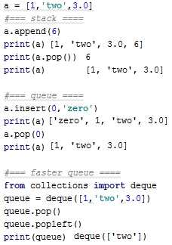
Stacks and Queues
Lists can easily be used as stacks with append & pop
We can use lists as queues as well..
But it’s inefficient (shifting all elements)
Better use the deque object
It has fast pops from both ends

Slide 3

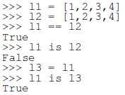
Comparing Sequences
Lists and other built-in classes support operator overloading
We can compare lists using <, ==, is
We can also compare other sequences
and all classes that implement __lt__()
(when using the list sort)

Slide 4
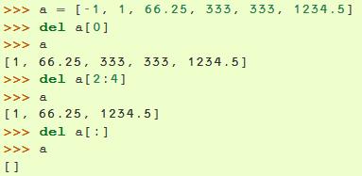
The del Statement
del removes item(s) from the list by their index
Unlike remove that searches for a value
Unlike pop that returns a value
del can also delete the entire list:

Slide 5
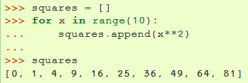

List Comprehensions
We can create lists using loops
We can also use
list comprehensions for
shorter syntax
We can also nest other for and if statements
The equivalence is longer
List comprehensions is usually very clear, but try not to reduce readability

Slide 6
List Comprehensions Exercises
Write a single-line command that maps a list of words into a list of integers representing the lengths of the corresponding words.
Now take another list of words and create a list by concatenating each element in the first list with each element in the second list.
Write a single-line function twoLetterSubs that gets a list of words and returns a list of all two-letter substrings that appear in those words.
For example: twoLetterSubs(['hello','world']) should return ['he', 'el', 'll', 'lo', 'wo', 'or', 'rl', 'ld'].

Slide 7
Tuples & Sets
We already met strings “123” and lists [1,2,3]
tuples (1,2,3) and sets {1,2,3} are two other data structures
A Tuple is an immutable sequence
It is not possible to assign values to items of a tuple
They support easy unpacking
Sets are unordered with no duplicate elements
They are good for membership checking
They support groups operations like union, intersection and difference

Slide 8
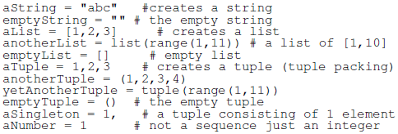

Creation of Sequences
Tuple unpacking

Slide 9
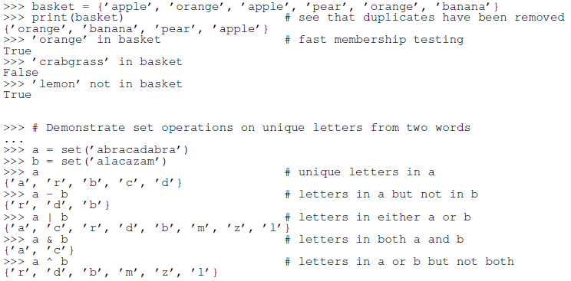
Set Operations
mySet = set() #creates an empty set
What will basket[2] return?
TypeError: 'set' object does not support indexing

Slide 10
Casting Data Structures
Set**** | Tuple | List | String | From/To
set(myStr) * | tuple(myStr) * | list(myStr)* myStr.split(sep)*** |  | String
set(myList) | tuple(myList) |  | sep.join(myList)** | List
set(myTuple) |  | list(myTuple) | sep.join(myTuple)** | Tuple
 | tuple(mySet) | list(mySet) | sep.join(mySet)** | Set****
* splits by char
** joins by sep
*** splits by sep
**** In all castings from/to sets the order is not guaranteed
Notes:
מדובר על עבודה עם מחרוזות או בהקשר של מחרוזות!
לא ניתן להפוך set או tuple למחרוזת אם היא לא הכילה מחרוזות!!

Slide 11
Tuples & Sets Exercises
Create a program that reads triplets of inputs from the user until the value 0 is read. The program will create a list of tuples representing cubes and will print that list. Then it will create a list of the cube’s volumes and print that list as well. Try to write the shortest code when creating tuples and reading their values.
Create a program that reads 5 different words from the user. Then the program will print a few empty lines and ask the user to provide the same words again from memory, not necessarily in the same order. The program will print out the words that the user remembered, the words that he forgot, and the excessive words.

Slide 12
Dictionaries
Dictionaries are mapping constructs
Consisting of key-value pairs
Also called associative arrays or hash maps
Keys can only be immutable: numbers, strings & tuples
Tuples keys can only contain numbers, strings & tuples
Creating dictionaries:
An empty dictionary: d = {}
Not to be mistaken with an empty set, which defined s = set()
A non-empty dictionary: d = {"alpha" : "A", "beta" : "B"}

Slide 13

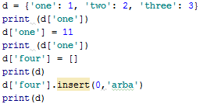

Dictionaries (2)
Other ways to create dictionaries:
Accessing, changing and adding values in a dictionary

Slide 14


Dictionaries (3)
Accessing a non-existent key
The del command deletes a key-value: del d['one']
The get() function returns a value for key and does not fail for a non-existent key

Slide 15
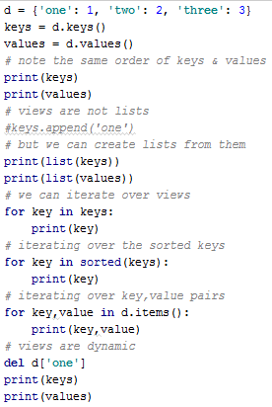






Dictionaries (4)

Slide 16


Dictionaries (5)
The update() function updates keys & values from another dictionary
Values of colliding keys are overwritten
dict comprehensions create key value pairs:
Note that there are also set comprehensions

Slide 17
Dictionaries Exercises
Write a function numberToDict() that gets a number and returns a dictionary mapping its digits location to their value, going from right to left. Then write the opposite function dictToNumber.
Write a function char_freq() that takes a string and builds a frequency listing of the characters contained in it. Represent the frequency listing as a Python dictionary. Try it with something like char_freq("abbabcbdbabdbdbabababcbcbab").

